Slide 1
Output Devices
Start

Slide 2
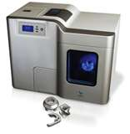
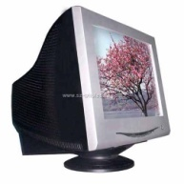
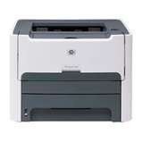
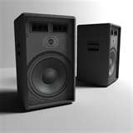
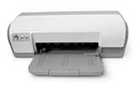
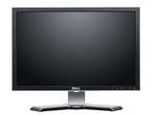
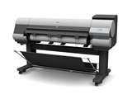
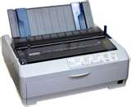
An Output Device
It is any device that displays an output from the computer.
CRT Monitors
3D Inkjet Printers
Laser Printers
Speakers
Inkjet Printers
TFT Monitors
Multimedia Projectors
Plotters
Dot Matrix Printer

Slide 3
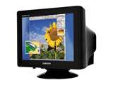
CRT Monitors(Cathode Ray Tube)
- Is the least expensive type of monitor
Are becoming less popular
Uses an electon gun to fire against a phosphor screen; creating a picture of tiny dots.
Uses
Used as primary output device so user can immediately what they are typing
Are used with light pens
Advantages and Disadvantages
Back to Output Devices

Slide 4
CRT Monitors
Advantages | Disadvantages
Produce higher quality than TFT monitors | They are heavy and there is a weight hazard if they are not supported properly.
Angle of viewing is better than TFT monitors | Run very hot and can cause fire if left unattended.
They can work with light pens in computer-aided design and computer-aided manufacturing. | Consume more power than the modern TFT monitors
 | The flicker which can lead to headaches and eyesight problems.
Back to Output Devices
Back to CRT Monitors

Slide 5
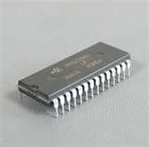
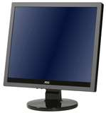
TFT Monitors (Thin Film Transistor)
The screen is made up of tiny pixels which are made up of transistors controlled by a microprocessor.
Uses
- Used as primary output device so user can immediately what they are typing
- Are an integral part of laptop computers
Advantages and Disadvantages
Back to Output Devices

Slide 6
TFT Monitors
Advantages | Disadvantages
Lightweight | Angle of viewing is fairly critical; several people cannot view it at the same time.
Produce less glare than CRT monitors and emit less radiation | It s definition (quality) may not always be as good as CRT’s
Consume much less power and do not generate as much heat as a CRT | Cannot yet be used with light pens
Back to Output Devices
Back to TFT Monitors

Slide 7
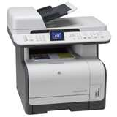
Laser Printers
Produce high quality hard copy output.
Print rate per page is very quick.
They rely on large buffer memories; where data is stored before the pages can be printed out.
Uses
Used where noise levels need to be kept low
Best option for fast high quality volume printing
Advantages and Disadvantages
Back to Output Devices

Slide 8
Laser Printers
Advantages | Disadvantages
Printing is fast for high volumes | Are expensive to buy
Can handle very large print jobs | Are fast if several copies are being made
Quality is consistently high | Colour laser printers tend to be expensive to run as different inks are needed.
Toner cartridges last for a long time; making laser printers cost effective. | They produce ozone and volatile organic compounds because of their method of printing.
Back to Output Devices
Back to Laser Printers

Slide 9
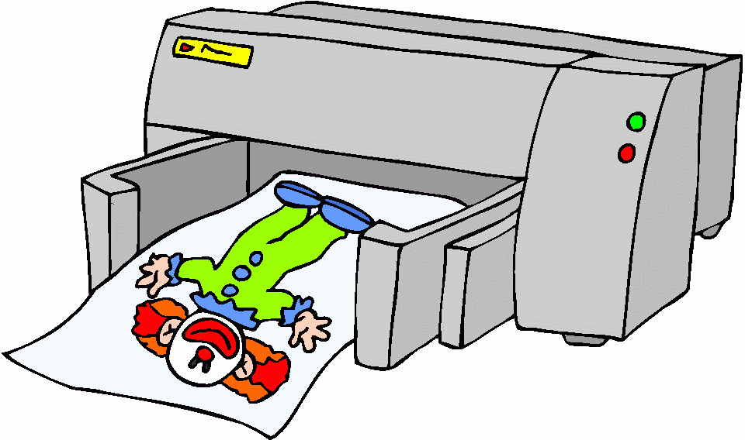
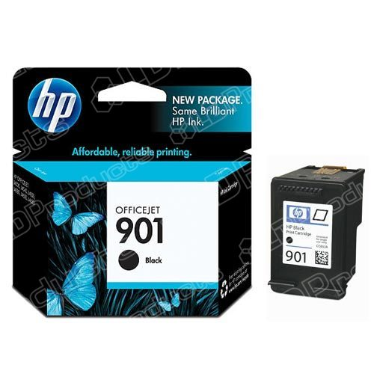
Inkjet Printers
They produce good quality hard copies.
They do not have large buffers; so printing is done a bit at a time.
Uses
Used where low output volumes are required
If high-quality for single pages is needed these printers are ideal.
3D inkjet printers have now been introduced in industry.
Advantages and Disadvantages
Back to Output Devices

Slide 10
Inkjet Printers
Advantages | Disadvantages
Output is of high quality | Slow output if there are several copies needed.
Inkjet printers are much cheaper to buy than laser. | Ink cartridges run out too quickly to be used for large print jobs
Are very lightweight and take up less place. | Printing can ‘smudge’
They don’t produce ozone and volatile compounds | They are expensive to run if they are used a lot; since original ink cartridges are expensive.
Back to Output Devices
Back to Inkjet Printers

Slide 11
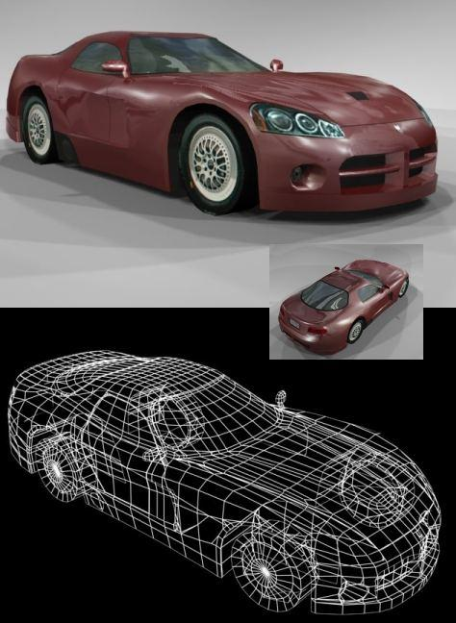
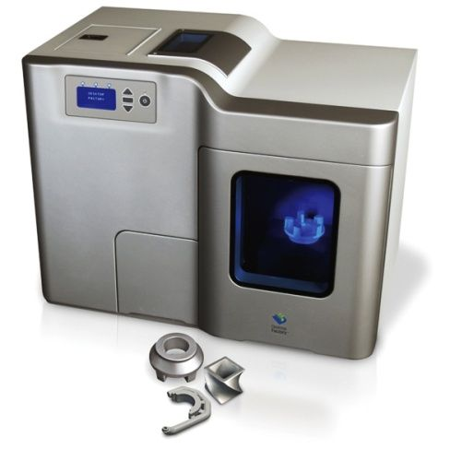
3D inkjet printers
They produce solid 3D models using modified inkjet technology
This technology is known as ‘tomography’; which is when thin layers of fine powder are bonded together as 3D model is slowly built up.
Uses
Used to make prototypes
Scale models can be made.
Produces organic objects.
Advantages and Disadvantages
Back to Output Devices

Slide 12
3D inkjet printers
Advantages | Disadvantages
Saves a lot of money; making prototypes by other means is expensive and time consuming. | Expensive to buy
Physical scale models produced with working parts; giving better idea of what the end product will look like. | Slow are producing output
Powders can be ground up and re-used. | End product can me a little rough and needs further work to be done to it.
Back to Output Devices
Back to 3D Inkjet Printers

Slide 13
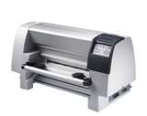
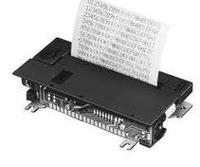
Dot Matrix Printer
It is an impact printer; print head presses against an inked ribbon.
They are slow, noisy and the output is not good quality
Uses:
- They can be used in noisy environments
Advantages and Disadvantages
Back to Output Devices

Slide 14
Dot Matrix Printer
Advantages | Disadvantages
Can be used in dusty, dirty or moist atmospheres | Very noisy, not good in office environment
Carbon copies or multi-part outputs can be produced | Cost more than an inkjet printer to buy
They are very cheap to run and maintain | Slow and printing is of low quality.
Ease to use if continuous stationary
Back to Output Devices
Back to Dot Matrix Printers

Slide 15
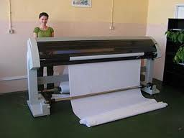
Plotter
Produce hard copies, but operate in a different way to printers.
They are not limited to normal paper size
They are able of producing highly accurate, very large drawings and posters
Uses
Produce large drawings
Print on plastic coated paper
Large signs can be made is pens are replaced with cutting ttools.
Advantages and Disadvantages
Back to Output Devices

Slide 16
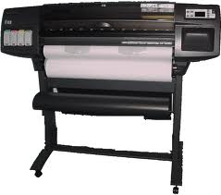
Plotters
Advantages | Disadvantages
Can produce huge printouts | Slow in operation
Print quality is extremely high | Expensive to buy and maintain
Back to Output Devices
Back to Plotters

Slide 17
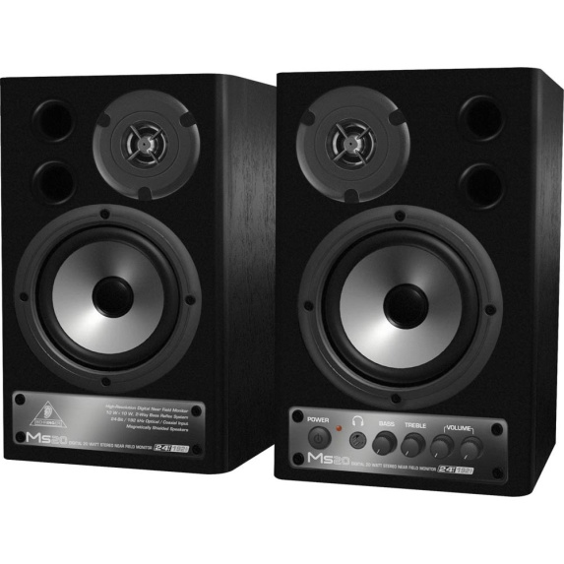
Speakers
They are connected directly to a computer
Uses
Used to output sound from multi-media presentations
Used in home entertainment centres
Can help blind people
Play downloaded sound files.
Back to Output Devices

Slide 18
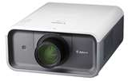
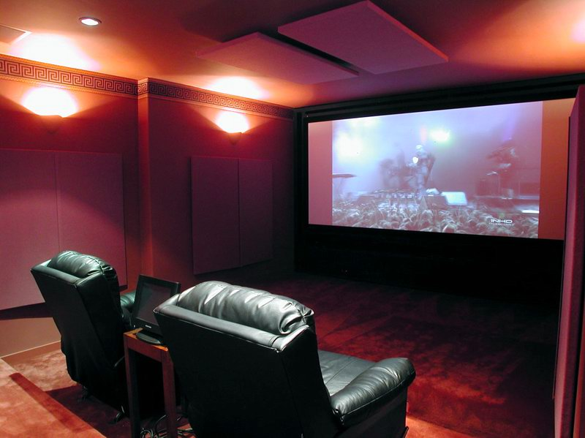
Multimedia Projectors
They take the image from a source ( usually a computer, TV or DVD) and project it onto a large screen.
Work with a remote control
Uses
Advertising
Training
Home cinema
Advantages and Disadvantages
Back to Output Devices

Slide 19
Multimedia Projectors
Advantages | Disadvantages
Enables many people to see a presentation rather than crowding around a small computer | Images can sometimes be fuzzy
Avoid the need of connecting several computers together | Are expensive
 | Setting them up may be slightly difficult
Back to Output Devices
Back to Multimedia Projectors

