Slide 1
Section 2
How Organizations Use ICT
Control systems

Slide 2
Content
Air conditioning systems
Central heating system
Refrigeration
Car manufacturer: industrial robots
Medical applications: intensive care
Process control

Slide 3
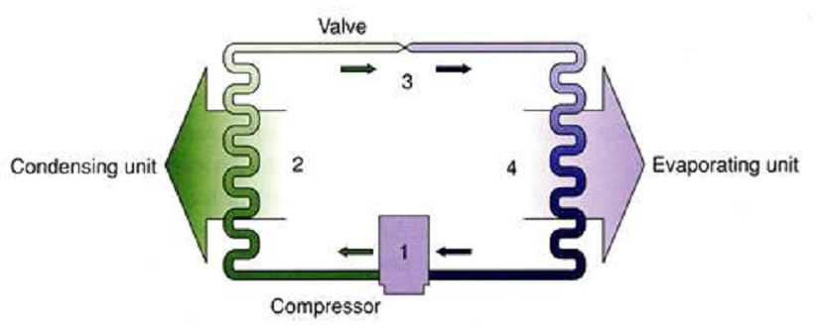
Air conditioning systems
The Air conditioning system is used to control the temperature conditions in a room.
The system has copper tubes(coils) containing a liquid that can easily be converted into gas and back to liquid( refrigerant)
The major parts of an air conditioning system are
Compressor: used to increase the pressure of the low-pressure gas into the
condensing unit
Valve
Evaporator

Slide 4
Air conditioning systems
Roles of the parts
1. Compressor: Increases pressure or pressurizes the refrigerant gas as part of the process of turning it back into a liquid
2. Valve: regulates the amount of compressed liquid refrigerant moving into the evaporator.
3. Condensing unit: Facilitates heat transfer
4. Evaporator: Receives the liquid refrigerant
Other parts
Fan(s) : To blows air across metal fins that have been chilled as a result of the heat being absorbed

Slide 5
Air conditioning systems
How it Works
The valve is controlled by microprocessor to reduce or increase the flow of refrigerant
Microprocessor compares the pressure of the refrigerant to the preset value
If pressure of refrigerant is above preset value, the microprocessor opens valve wider
If pressure of refrigerant is below preset value microprocessor makes valve opening
Narrower
Touch screen is used to input the required temperature.
Temperature sensor captures temperature in the room which is converted by the Analogue-to-digital converter(ADC) into digital data.
Microprocessor compares the temperature of the room to the preset value
If temperature of the room is above the pre-set value the fans remain on/are switched on by the microprocessor or microprocessor increases their speed.
If temperature of the room is below the pre-set value the fans remain/switched off by the microprocessor

Slide 6
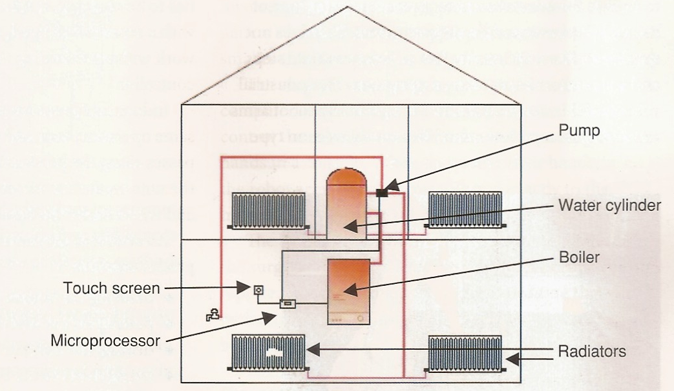
Central-heating systems:
The main parts of a central-heating system consist of:
Boiler: a hot-water cylinder,
Pump
some radiators.

Slide 7
Central-heating systems:
How a microprocessor controls the central-heating system?
Users press the touch screen to select the temperature they want.
The microprocessor reads the data from a temperature sensor on the wall and compares it with the value the user has requested.
If it is lower, then the microprocessor switches the boiler and the pump on.
If it is higher, the microprocessor switches both off.
In order for the microprocessor to ‘understand’ the data from the temperature sensor (which is an analogue variable sensor), it uses an ADC to convert this data to a digital form that it can process.
The microprocessor controls separate actuators: one opens the gas valves in the boiler and the other switches the pump on.
The microprocessor usually has the capacity to control the times at which the system switches itself on and off. For example, users can set the system to come on an hour before they wake up in the morning, so that the house is warm to get up to and set it to switch off 30 minutes before they go out to work. It can be set to switch on one hour before they return from work, and so on.
When the system is off, the microprocessor ignores all readings.

Slide 8
Revision Qns
Describe how microprocessor control is used in a central heating system

Slide 9
Scenario 1
South African Motors is a car engine manufacturing company which has just started manufacturing complete cars. They are looking to sell cars throughout Africa. The factory is in East London and they have a main office in Johannesburg, where the manager, Simphiwe, organises the day to day running of the business. The main office employs a lot of workers to produce the company payroll for all the workers in East London and for those in Johannesburg. There is also a human resources department in the main office in Johannesburg which keeps all the files on each worker. Simphiwe has asked Capetown Publicists, an advertising company, to publicise the business on a large scale. The publicist company employs 4 people including the manager Mosola. They need to have regular meetings to discuss their progress with various jobs. This is difficult as they are very rarely in the office together as they all do a lot of their work at home.

Slide 10
Scenario 1 Qns
1 (a) The company uses robotic arms to control a number of processes. Give two reasons why they use these robotic arms.
Describe how robotic arms are used in two of these processes.

Slide 11
Scenario 1 Answers
A robotic arm has greater accuracy compared with a human
There are lower running costs compared to paying a human being
Robotic arms do not get tired so work is of a consistent standard
The whole process can be continuous without having to stop at shift changeovers
Painting the car bodies
Putting the car wheels on
Drilling holes in car body
Fixing rivets to the car body
Tightening bolts
Assembling the electric circuits in the car
Inserting the car engine
End effectors are attached to robot arm such as –
Paint sprayer
Drill
Riveter
Ratchet/spanner
Pressure sensors are used to tell the computer whether the effector is being
held firmly enough or too firmly

